Slide 1

Add here
[Your brand name here] + UpGuard
Working with InfoSec on Vendor Security Reviews
A guide to the security request process for new vendor onboarding and contract renewal.

Slide 2

Why do we need security reviews?
Vendors play a critical role in how we operate, which means the way they handle data, systems, and access directly affects our business. Third parties are also one of the most commonly targeted paths for cyber attacks, making vendor security a critical consideration. Security reviews help ensure vendors can support our objectives without introducing unnecessary risk. By reviewing vendor security practices upfront and at key points in the relationship, the business can make informed decisions about which vendors we work with and how they’re used. This reduces the likelihood of disruption or incidents that may materially impact our customers, operations, and reputation.

Slide 3

When security reviews happen
Security reviews occur at defined stages in the vendor lifecycle, based on the level of risk a vendor presents and how the relationship evolves over time. At [Company], vendor security reviews are typically required at the following points: Initial onboarding Contract renewal Ongoing reviews every ___ months/year for higher-risk vendors Ongoing reviews every ___ months/years for lower-risk vendors Additional reviews triggered by material changes (e.g., scope changes, security incidents, new data access) This approach helps ensure security expectations remain aligned over time without introducing unnecessary friction.
Add here
Add here
Add here

Slide 4






How we manage security reviews
To manage third-party cyber risk consistently and at scale, we use UpGuard, a SaaS platform that supports our end-to-end third-party cyber risk management program.
UpGuard allows InfoSec to run security reviews in a structured, governed way while giving business teams a clear and predictable process to request and track reviews. Security assessments are handled within the platform which helps to streamline the assessment process and prevent delays.
For business teams, UpGuard supports the vendor assessment process by making security reviews easier to initiate, track, and complete:
Requests are submitted in one place using a standard process
The information InfoSec needs is captured upfront
Progress and outcomes are visible throughout the review
There is less back-and-forth and fewer manual follow-ups
Vendor onboarding is less likely to stall due to unclear requirements

Slide 5
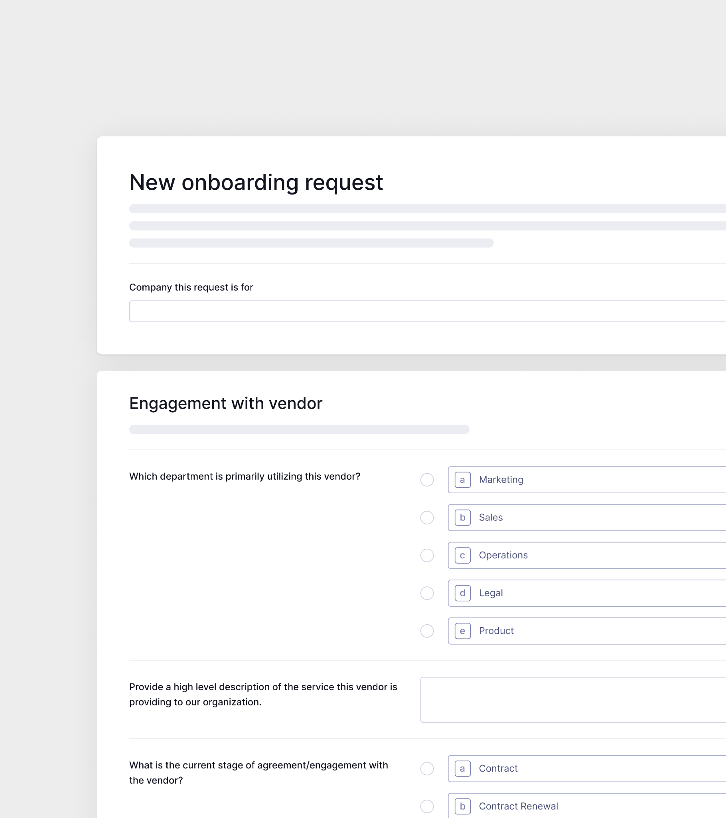
What business teams are responsible for
To help security reviews progress quickly, business requestors play an important role by providing accurate and complete information at the time of submission.
Before submitting a request, aim to have: Vendor names and primary business owner What the vendor will be used for The type of data involved (if any) The level of access the vendor will have Any known time constraints or target onboarding dates The business criticality of the product or service Providing this information upfront helps InfoSec assess the request proportionately and avoid follow-up questions that can delay onboarding.

Slide 6
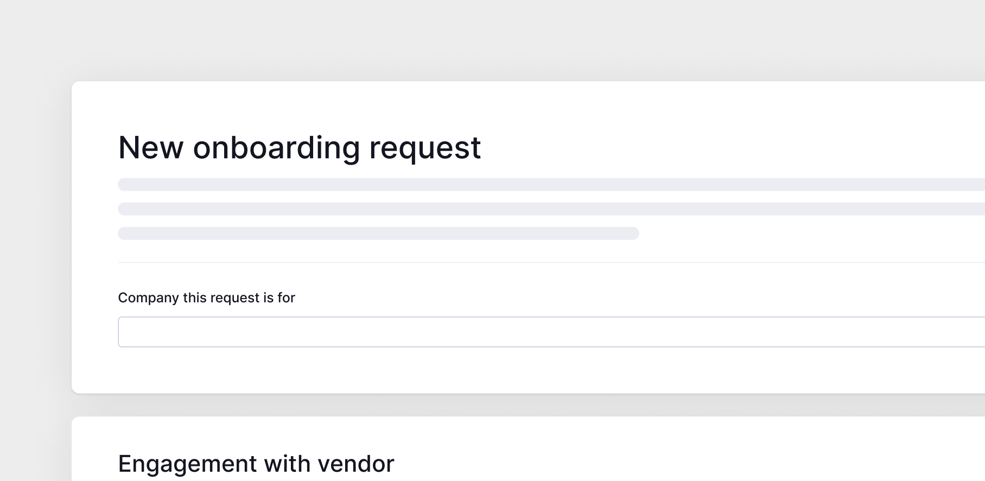
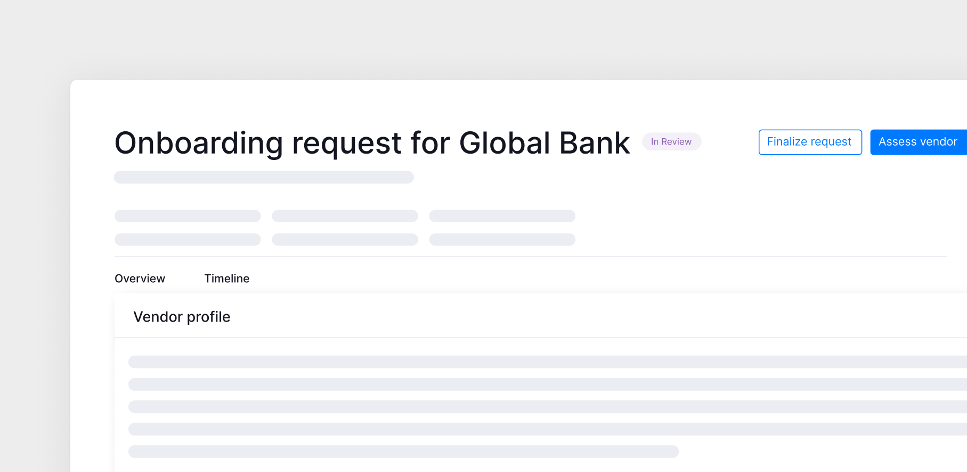
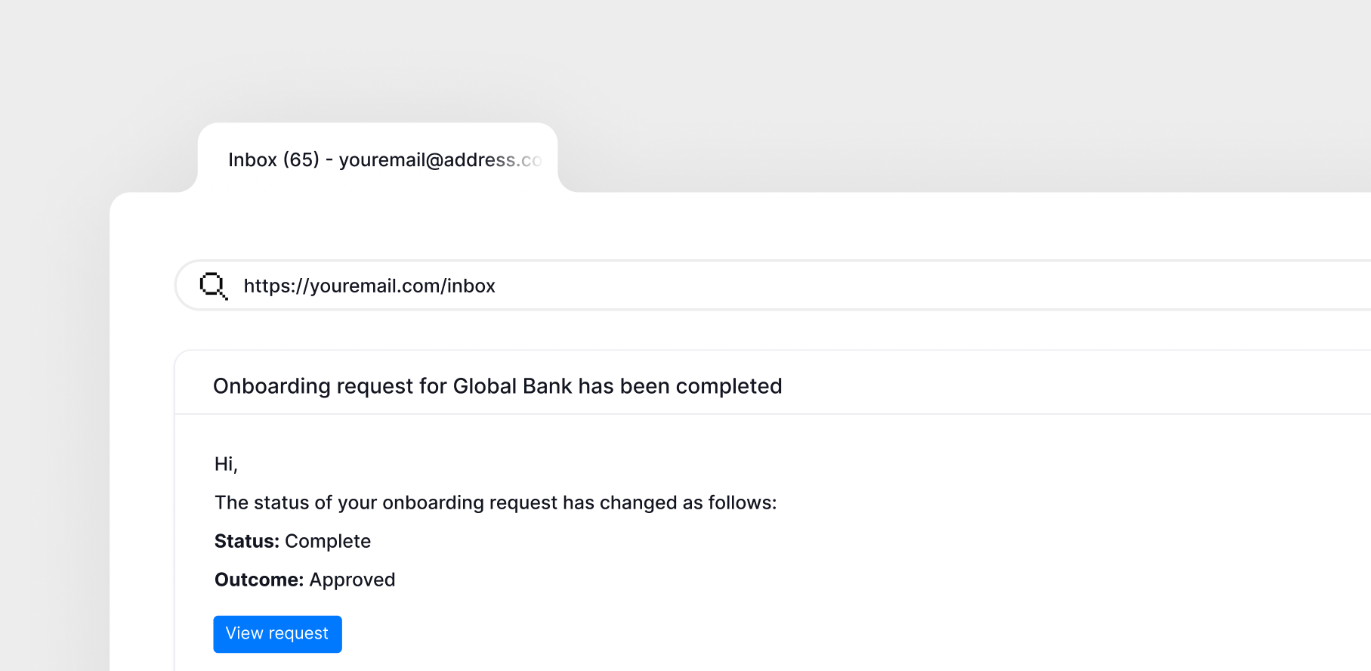
Submitting a vendor security request via UpGuard
All vendor security requests should be submitted through the UpGuard Vendor Onboarding Portal. This portal is the starting point for initiating a security review and ensures requests reach InfoSec with the right information from the outset.
Step-by-step process
Submit a vendor security assessment request Access our UpGuard Vendor Onboarding Portal here: [insert portal location link] Enter your work email Follow the SSO prompts or check your email for the verification message and click the link to access the intake form. Complete all necessary fields in the form. Hit the ‘Submit request’ button. You’ll receive a confirmation email shortly after.
InfoSec will review the request in UpGuard and decide if the vendor requires a formal security assessment: If yes = Assessment is then launched, with outcomes shared once available. If no = Analyst makes an immediate determination and responds to the request.
You’ll receive notification of the outcome, along with the risk assessment (if complete) and instructed on any further action that may be required.
Add here

Slide 7

Add here
Add your logo here
Add here
To learn more about our security review process, contact [CONTACT NAME] or visit [LINK].
To learn more about UpGuard, visit www.upguard.com

